Slide 1

Modern Control Theory
Lecture No. 13
Minimizing the Covariance
Obtaining the Kalman Gain
Formulation of the Kalman Filter

Slide 2
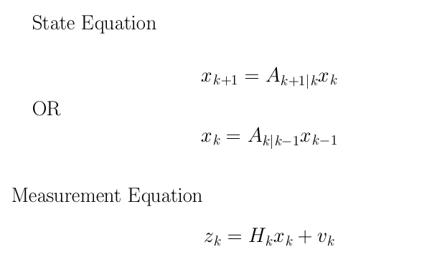
Simplified Derivation for a Deterministic & Unforced Dynamical System

Slide 3





Prediction & Update
Update
(k-1)+
Prediction
(k)-
(k)+
k-1
k
z(k-1)
z(k)

Slide 4
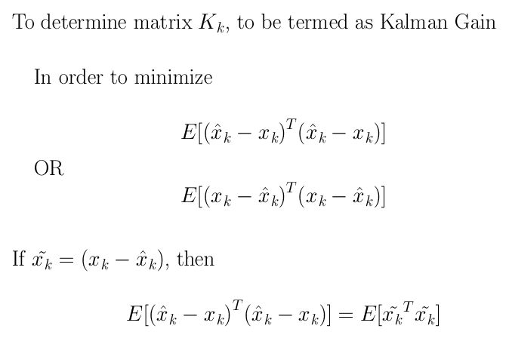
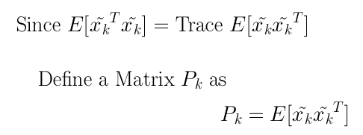
Kalman Gain & Covariance

Slide 5
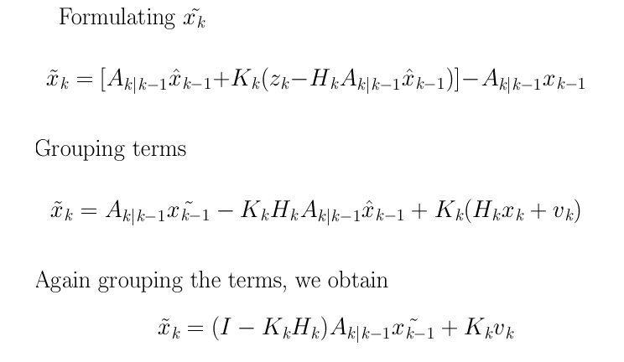
To Obtain the Expression for Covariance
Step 1 :

Slide 6



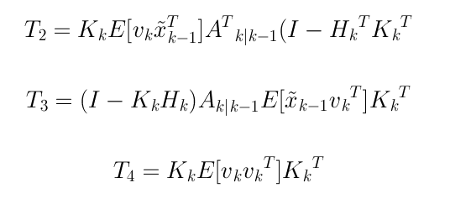
Obtaining the Covariance Matrix
Step 2 : Expanding the term

Slide 7
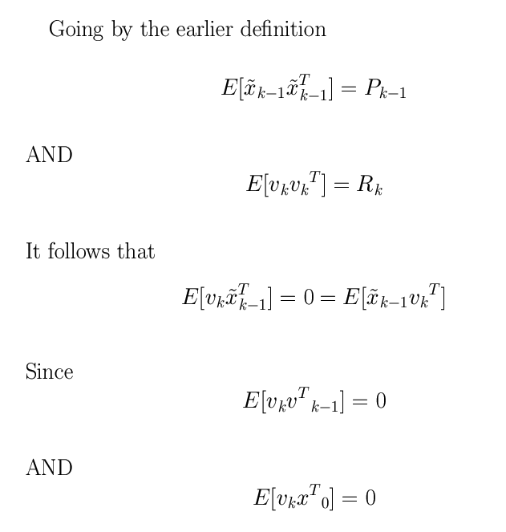

Slide 8
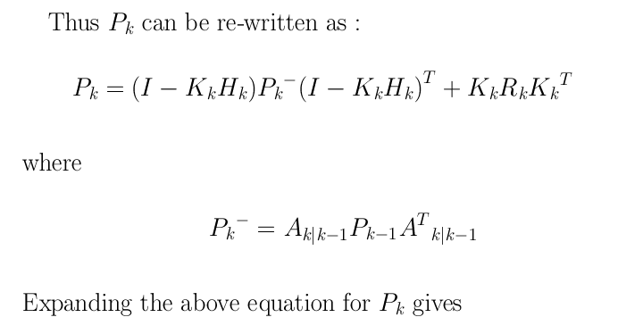
Obtaining Apriori P

Slide 9




Obtaining K

Slide 10
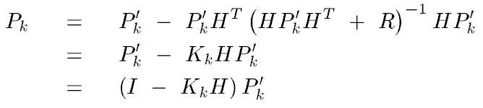
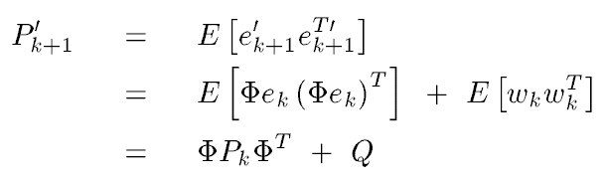
Obtaining the P Matrix

Slide 11
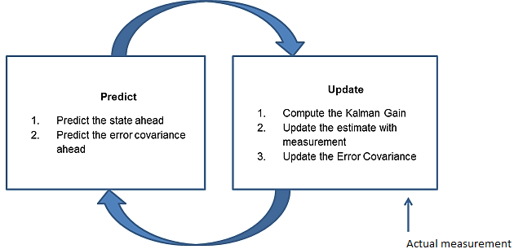

Slide 12
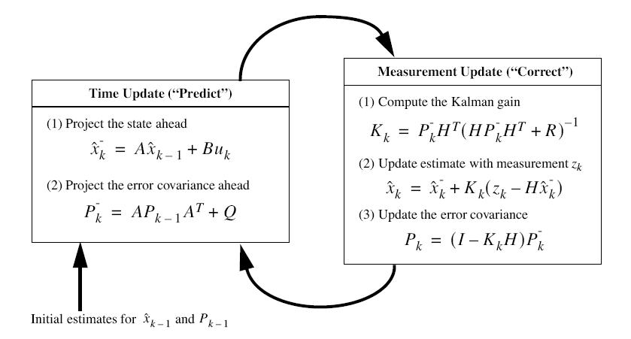
The Kalman Filter

